Slide 1
Technical Report
Title
Avoid prove, cause and effect
Should be informative
Introduction
Methodology
Report
Conclusion

Slide 2
Methodology
Establish quality of your data
Discuss statistical techniques you will use in your analyses.

Slide 3
Establishing Data Quality
Where did data come from? Who collected it? Who funded it? (Reputable?)
Ongoing study? If so, how long?
Specifics about sampling plan:
Population under study
How many students participated (in 12th grade survey)?
Specifics about sampling plan (representative)?
How were students selected
When was survey administered?
Issues related to undercoverage
Issues related to nonresponse
Measures to protect confidentiality

Slide 4
Statistical Techniques
Chi-square
Two-way tables
Time series
R for analysis
Preparation of data

Slide 5
Report
Reporting on chi-square test results:
The association between A and B is found to
be significant (X² = ___, df = ___, p = ___).
No need to state: Reject null hypothesis, etc.

Slide 6

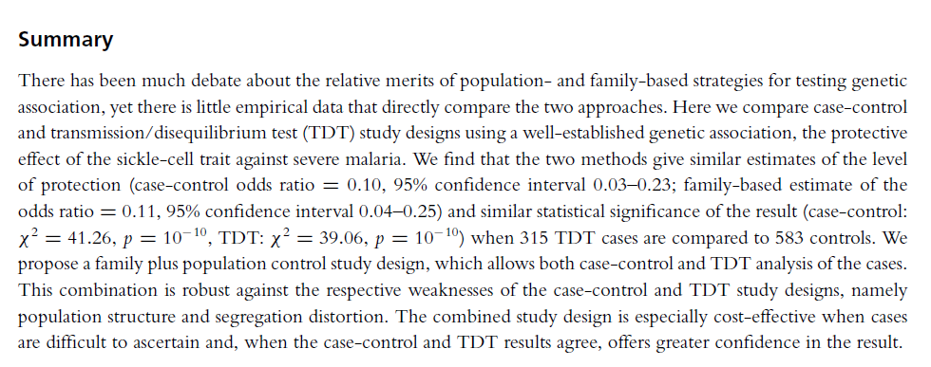

Slide 7
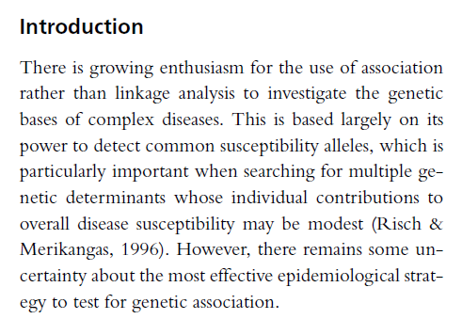
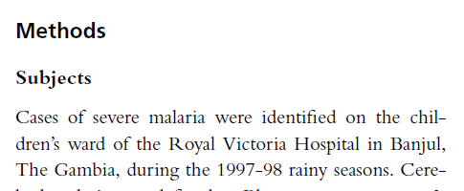

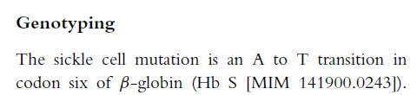


Slide 8
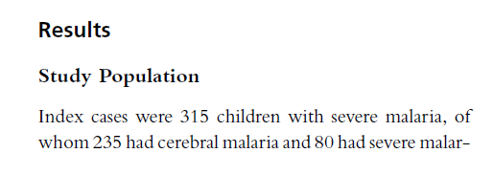
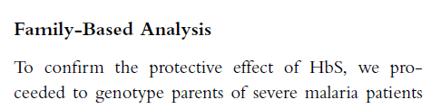
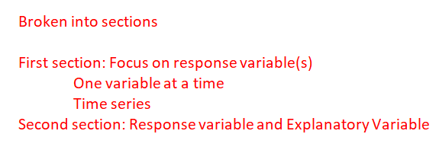

Slide 9
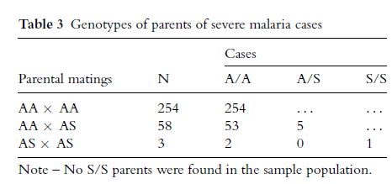
Structure of Section
Begins with introductory sentence(s).
Any graphic display must have a Figure # and caption
Any table must have a Table # and caption

Slide 10
Expectations For Work on Report
Monday April 19th: Groups present topics via Teams
Continue working on Stage 2:
If necessary, modify your data frame.
Research articles to provide support in paper
Draft of Introduction and Methodology section
Add to report section:(Recall each Team member: Take a section and complete an analysis.)

Slide 11
Citation Guide
https://pitt.libguides.com/citationhelp
APA
MLA

Slide 12
Stage 2: Write drafts:
Introduction – should contain descriptions of the following:
What report is about
Why topic is important (Give reader a reason that they should be interested in reading your report.)
Introduce research questions that you hope to answer (Don’t need to be a list – more about what you plan to investigate.)
Support why topic is important with a discussion from a research article or news article. (Want at least two references beyond MTF codebook, at least one must be from a research article as opposed to a newspaper article.)

Slide 13
Stage 2 (continued)
Methodology (two parts)
Establish quality of your data: say something about organization or study charged with collecting the data, describe sampling plan, discuss potential bias, potential flaws in study, etc.
Discuss statistical techniques that you plan to use in your analyses.

Slide 14
Stage 2 (Continued)
Report: Each team member should write one section of the report (draft):
Take a research question involving two variables. Create two-way frequency table – use it as basis for analysis of the relationship of the two variables
Start with a chi-square test
Conditional percentages for the response variable for each level of the explanatory variable.
Graphic display
Discussion

